Slide 1



Machine Learning and SQL Server
by Bryan Cafferky
Course Content @
https://github.com/bcafferky/shared/tree/master/DataScienceFromAtoZ

Slide 2


About Bryan Cafferky…
Data Solutions Enabler (TSP)
Decades of IT Experience in health care, insurance, banking, and ecommerce.
Microsoft MVP.
Author of Pro PowerShell for Database Developers.
Founded and lead PASS Chapter The RI Microsoft BI User Group and The SNE R User Group.
Frequent presenter at technical conferences and user groups.
bryan256@msn.com
www.sql-fy.com
https://www.linkedin.com/in/bryancafferky
@BryanCafferky – follow me!
Subscribe to me on YouTube!

Slide 3

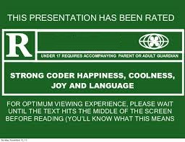
For Language and graphics
Course Content @
https://github.com/bcafferky/shared/tree/master/DataScienceFromAtoZ

Slide 4
Schedule
Morning: 9:00 AM – 12:00 PM
Afternoon: 12:30 – 3:00 PM
Part 1 – 9:00 – 10:00 AM
Jumpstart with Azure Data Science VM
Jupyter Notebooks
Lab
Part 2 – 10:15 AM - Noon
R Programming
Predictive Modeling
Lab
Part 4 – 12:30 – 1:45 PM
Scaling Up with SQL Server/ML Server
Lab
Part 5 – 2:00 – 3:00 PM
Machine Learning On Spark with Azure Databricks
Lab
Lunch: Noon – 12:30 PM

Slide 5

Time to Find Your Inner Child!

Slide 6

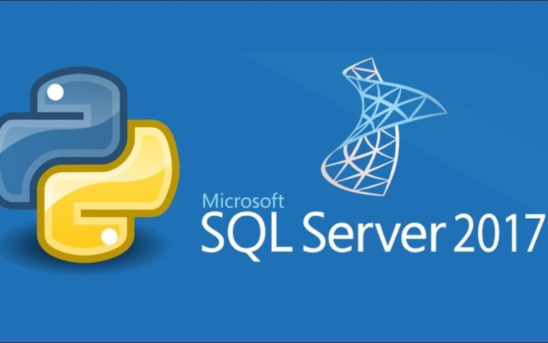


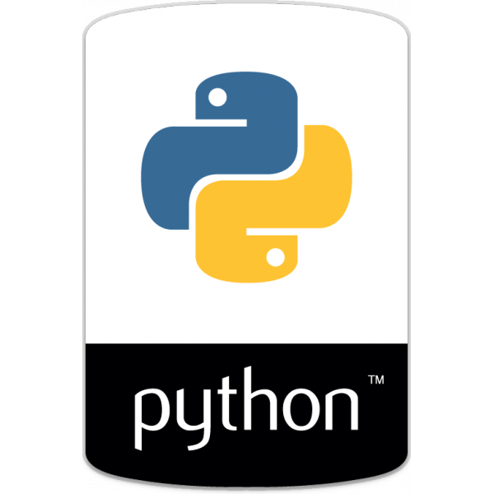



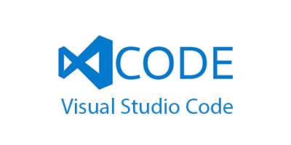
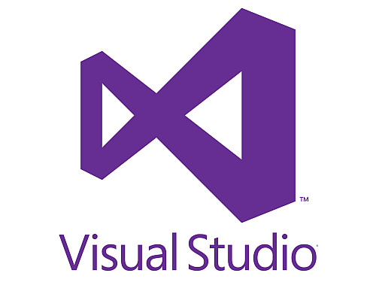
The Azure Data Science Virtual Machine

Slide 7
Demo
Creating a Data Science Virtual Machine
scr_opening_speech.R

Slide 8
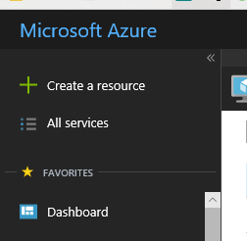
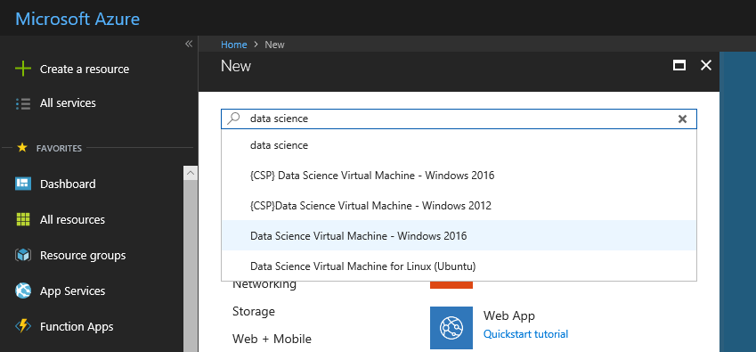
Creating an Azure Data Science VM
Start typing what you need…
Click on Create a resource

Slide 9
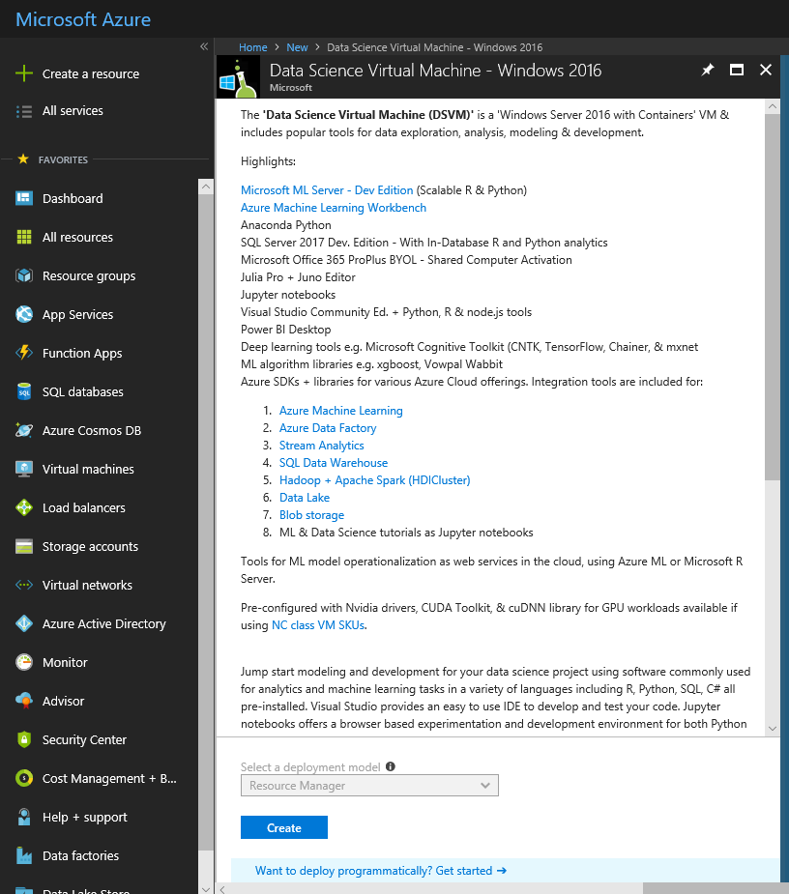
Creating an Azure Data Science VM
Click on Create

Slide 10
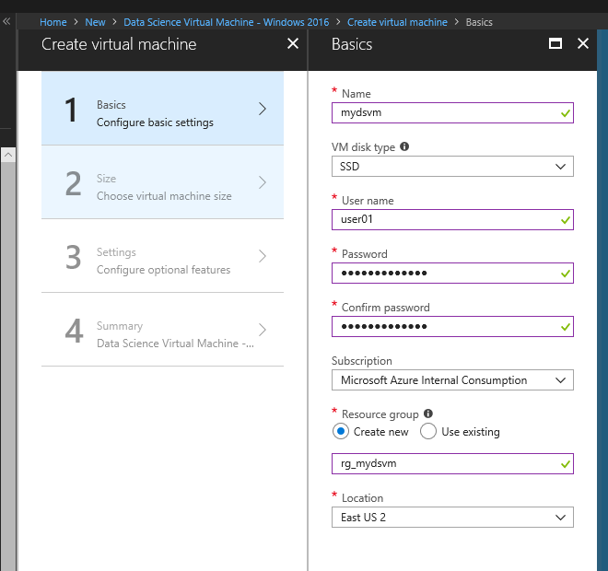
Creating an Azure Data Science VM
Fill in the Details…
The resource group is a container that holds all the asseets created as part of your VM

Slide 11
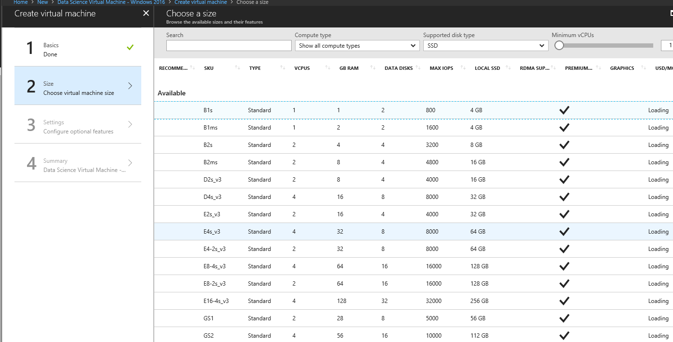
Creating an Azure Data Science VM
Make sure you select enough resources to run the tools!

Slide 12
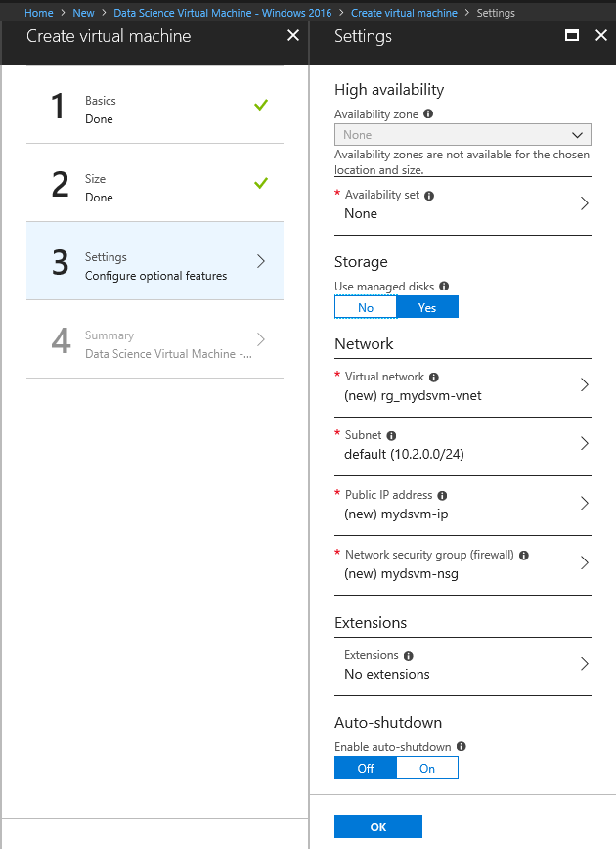
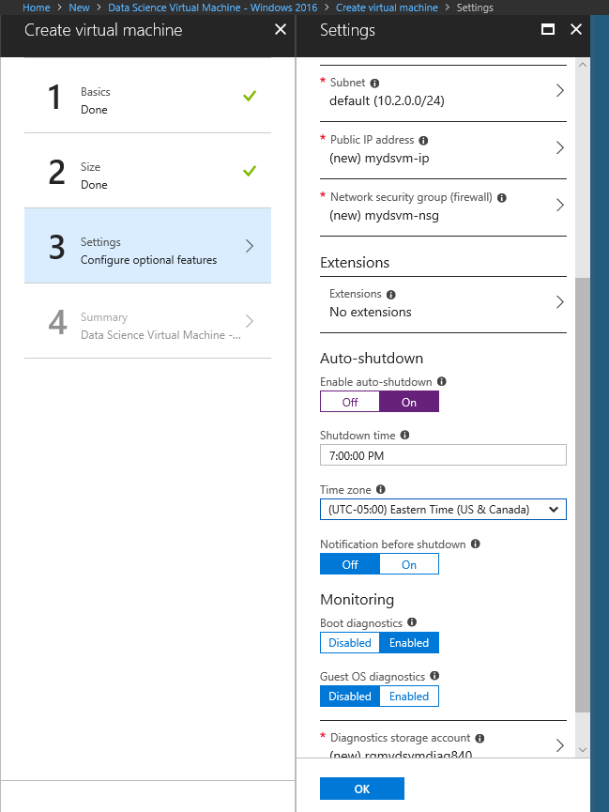
Creating an Azure Data Science VM
Define when to shut the VM down.
Auto Shutdown will save you money!

Slide 13
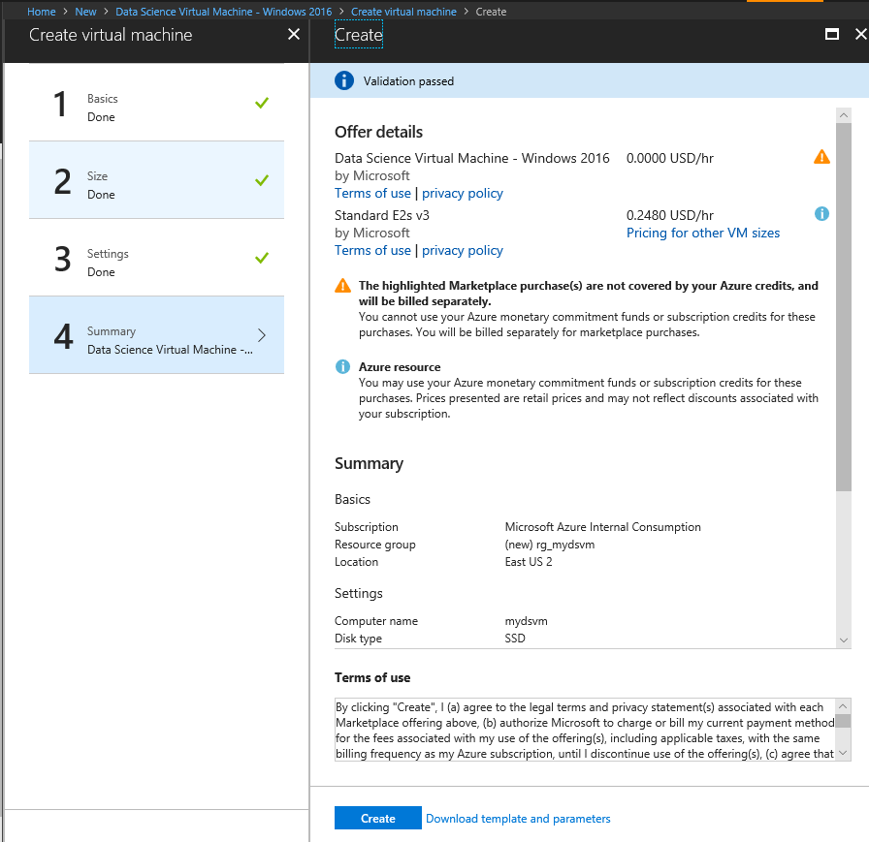
Creating an Azure Data Science VM
Click on Create.

Slide 14
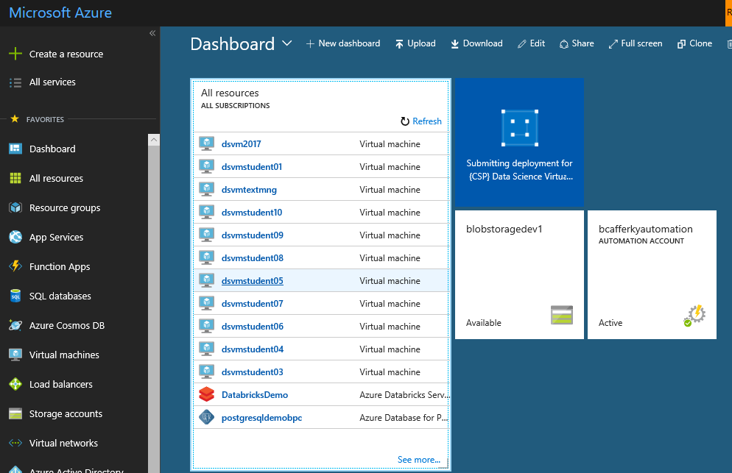
Creating an Azure Data Science VM
Resource is being created.

Slide 15
Connecting to Your DSVM

Slide 16
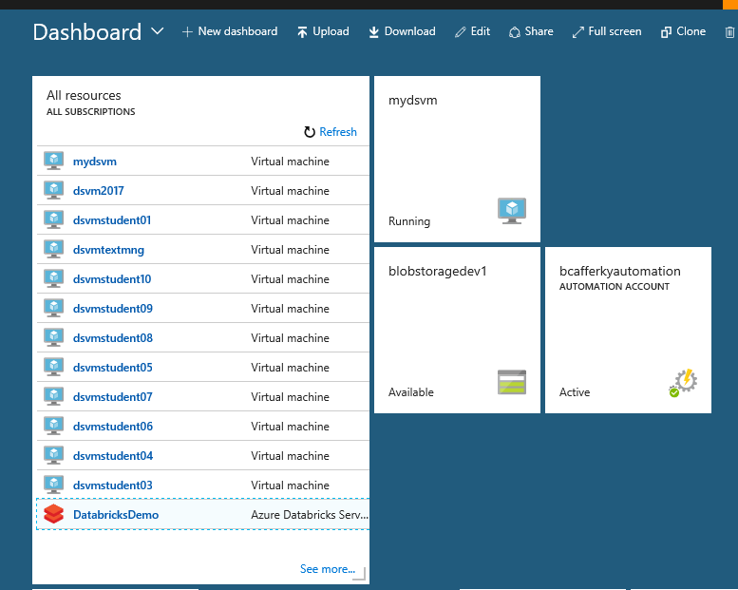
Connecting to Your DSVM
Select the VM.

Slide 17
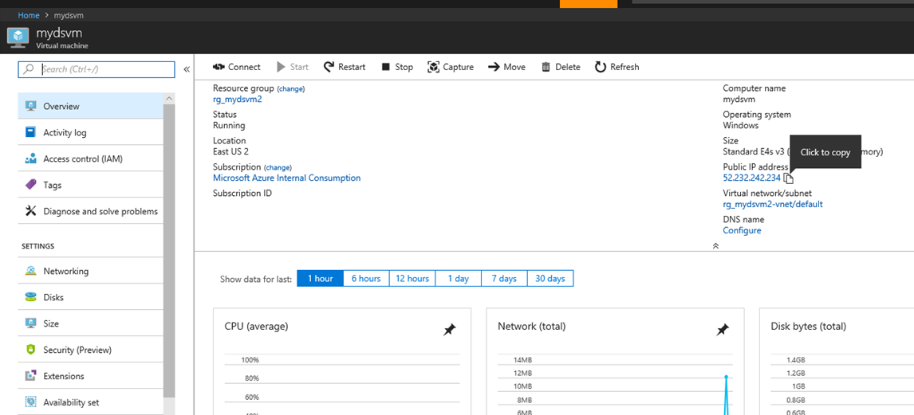
Connecting to Your DSVM
Copy the IP Address

Slide 18
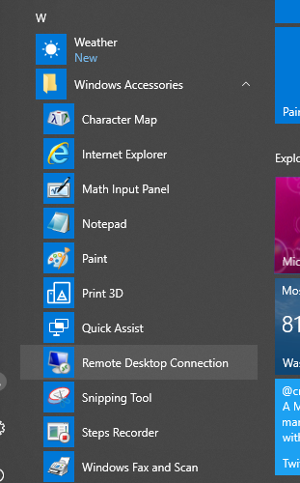
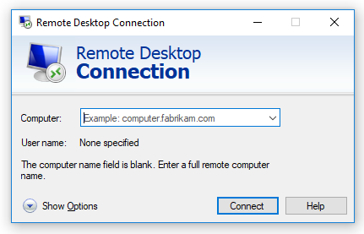
Connecting to Your DSVM
Paste the VM IP Address and click Connect.
Start Remote Desktop.

Slide 19
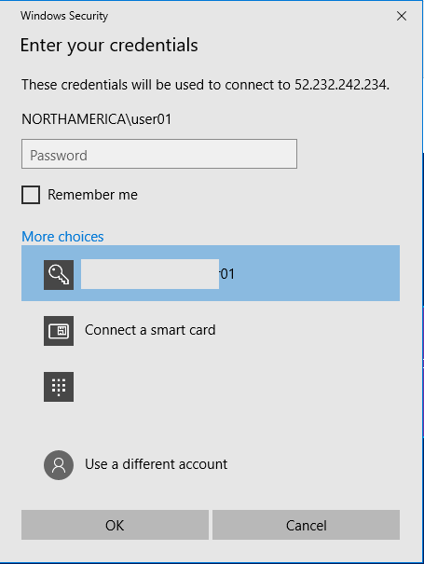
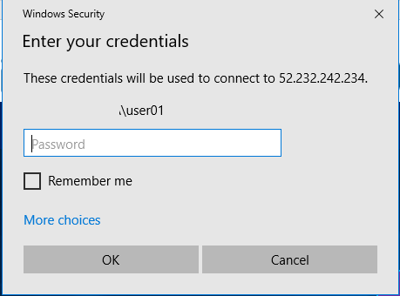
Connecting to Your DSVM
You may need to click on More choices.
Use a different account.

Slide 20
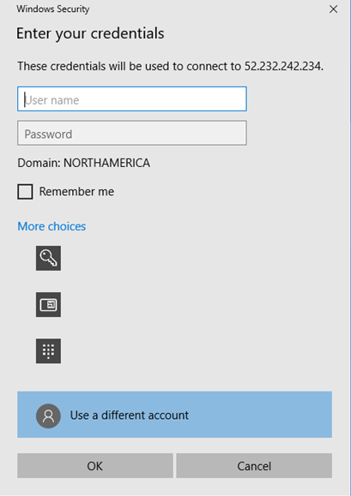
Connecting to Your DSVM
Enter the admin user account and password you set for the VM and click Ok.

Slide 21
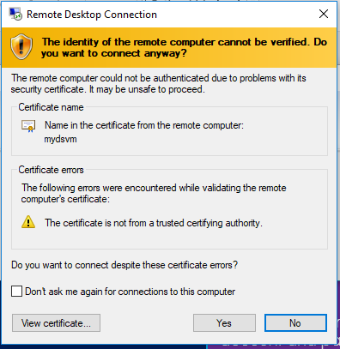
Connecting to Your DSVM
If you see this popup, just check the Don’t Ask me again check box and click Yes.

Slide 22
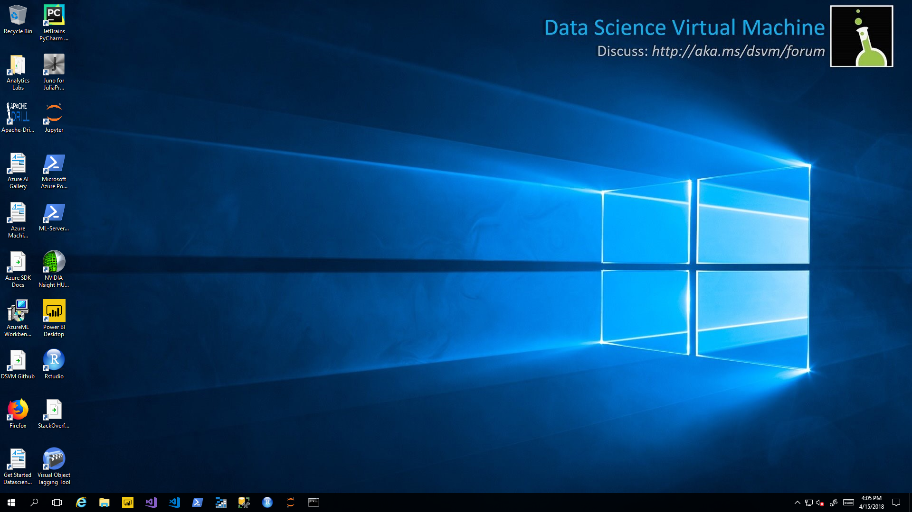
Connecting to Your DSVM
Wait until the VM is set up and Initialized. This can take a few minutes. Be patient.

Slide 23
Connecting to Your DSVM
You’re Good to Go!!!

Slide 24


Integrated Development Environments
RStudio
Most popular and feature rich IDE.
Only Supports R Language
R Tools for Visual Studio
Powerful Multi-Language, Multi-Platform.
Others

Slide 25


An Introduction to R Jupyter Notebooks
R

Slide 26
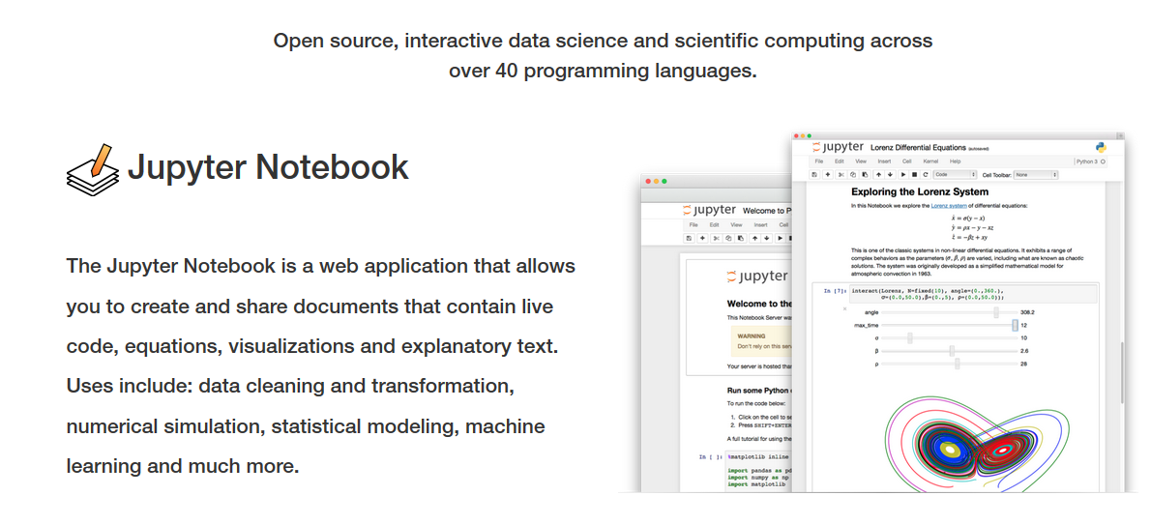
What is Jupyter Notebook?

Slide 27

Jupyter Notebook
Open Source
Written in Python – originally called IPython
Real time execution and rendering.
Many languages supported.
Supports Spark API (pySpark, SparkR)
Can share via GitHub, JupyterHub, and Azure.
Built-in Viewer Support in GitHub.

Slide 28
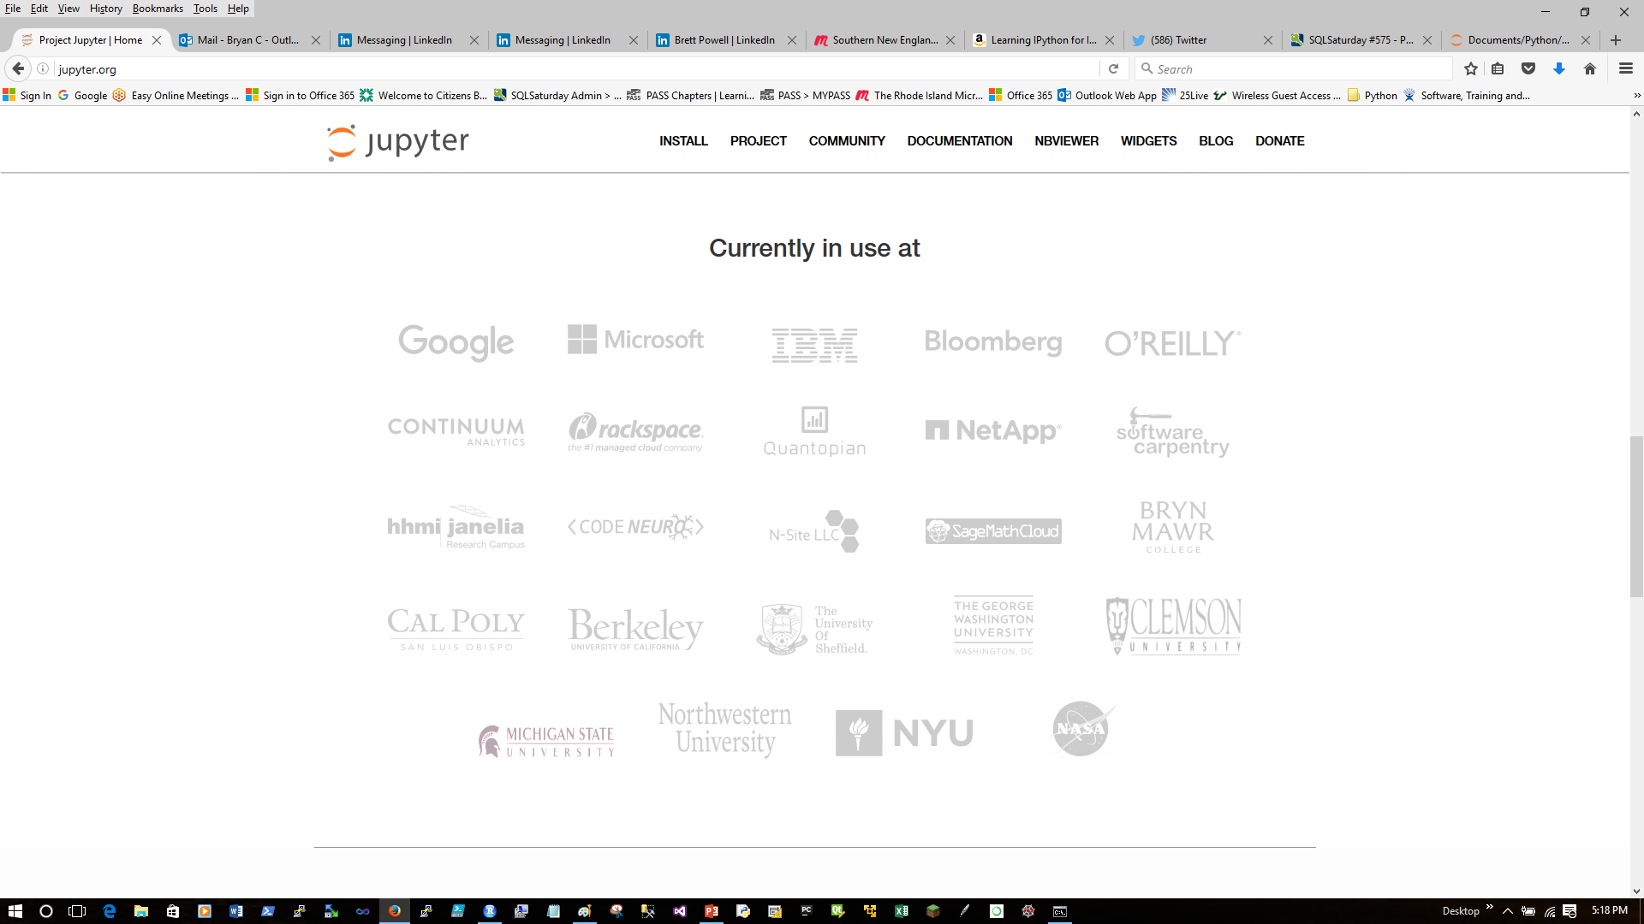
Who uses Jupyter Notebooks?

Slide 29
What’s in a name?
Emphasizes multi-language support.
Jupyter
R
Julia
Python

Slide 30
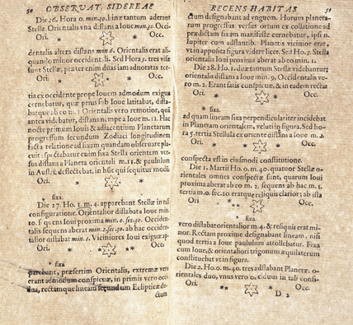
Why Notebook?
From Galileo’s Notebook –
Drawing’s of Jupiter’s satellites.

Slide 31
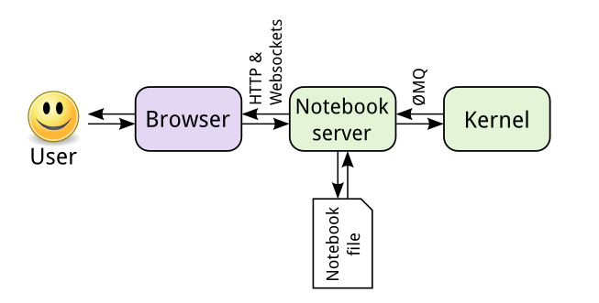
Kernel Architecture
JSON format
Can be many kernels:
Python
R
Julia
Ruby
Perl
PowerShell
http://jupyter.readthedocs.io/en/latest/architecture/how_jupyter_ipython_work.html

Slide 32
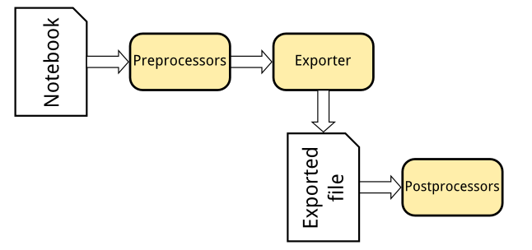
Flexible Notebook Conversions
nbconvert
Formats include:
HTML Slides
PDF
Markdown
Script
http://jupyter.readthedocs.io/en/latest/architecture/how_jupyter_ipython_work.html

Slide 33
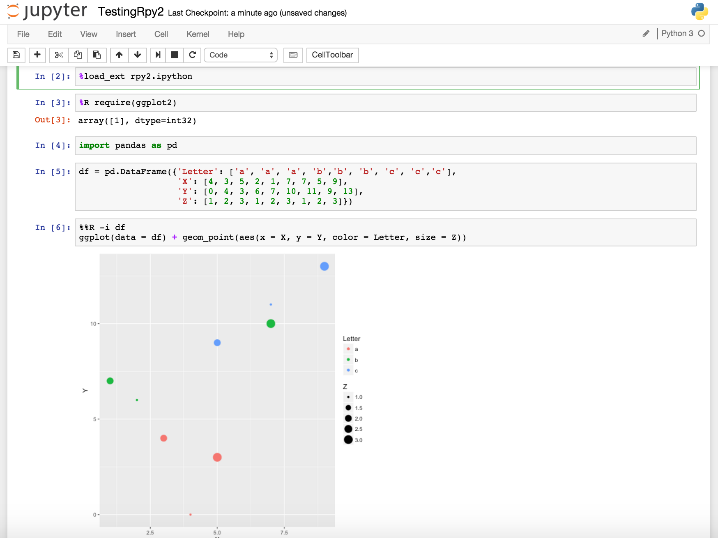
What is Jupyter Notebook?
Execute the cell
Command Prompt called a cell
Code executes in real time.
Can go back, edit and re-run cells.
Like a cross between a command line and Excel spreadsheet.
Rich visualizations rendered inline.

Slide 34
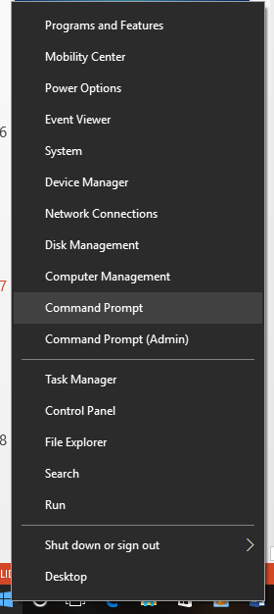
Starting Jupyter Notebook
Start the command shell.

Slide 35
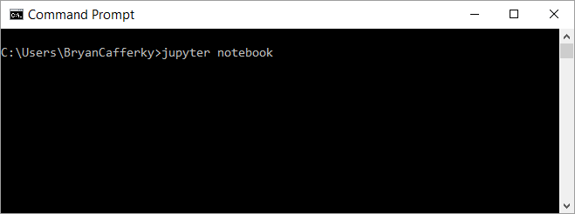
Installing Jupyter Notebook
Start the Jupyter Notebook
Windows Command Prompt
Note: The notebook starts pointing to the folder from where the notebook was started.

Slide 36
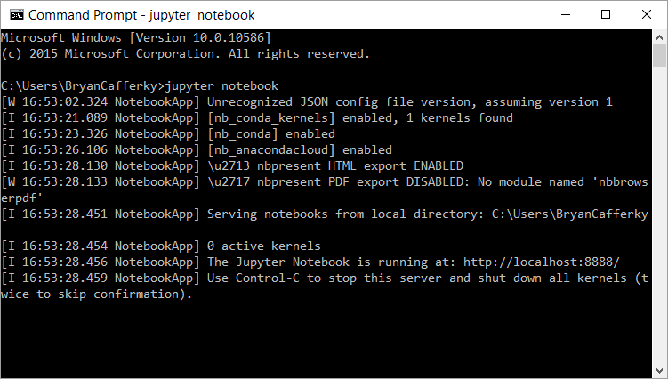
The Jupyter Server Running

Slide 37
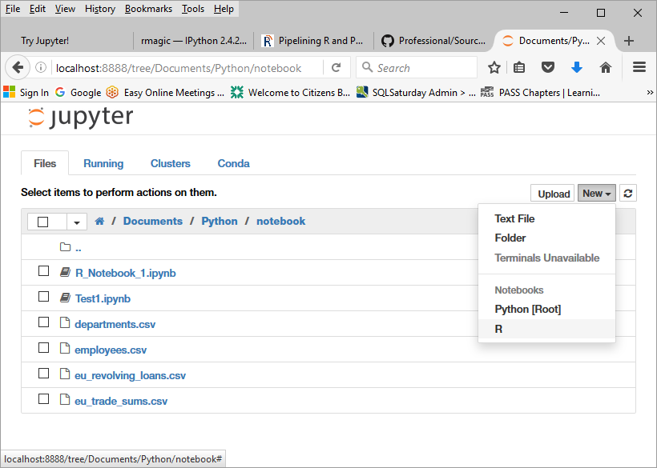
A First Look at a Notebook
Select New and the kernel, i.e. R

Slide 38
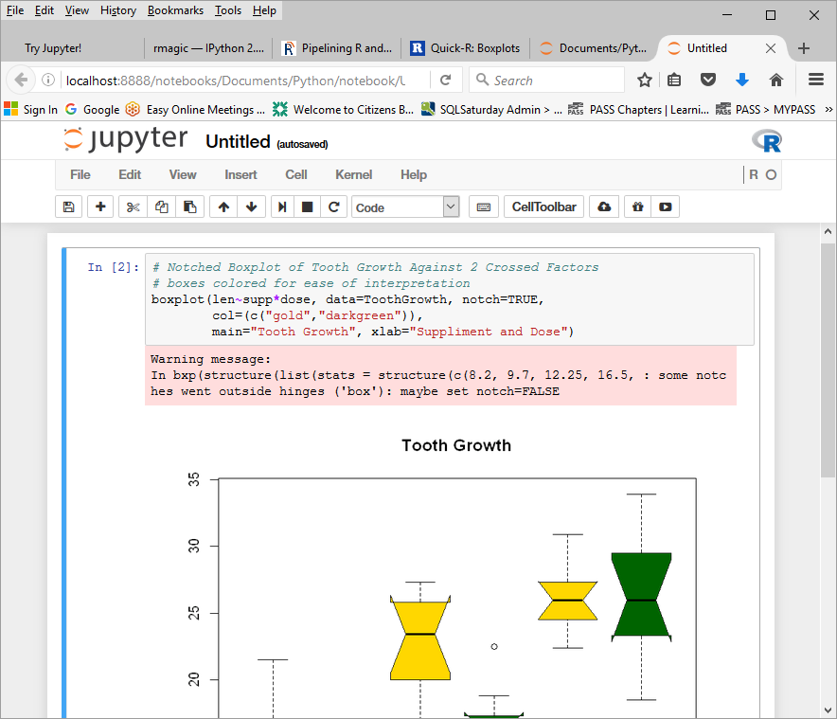
A First Look at a Notebook
Kernel Running
Enter R code and press Shift + Enter
Or
Click on

Slide 39
The Cell Toolbar
Save Notebook
Cut Cell
Copy Cell
Move Cell Down 1
Stop Cell Execution
Insert Cell
Paste Cells Below
Move Cell(s) Up 1
Run Code in Selected Cell(s)
Restart the Kernel
Set Cell Content Type

Slide 40
Exploring Jupyter…
New notebook
Sample notebooks
Python
R
Cell Magic
Widgets

Slide 41
Use R and Python Together…
Loads R Python Extension
%R to run R code in the cell
Default language is Python 3
R ggplot call passing data frame, df, from Python
%%R defines data to be passed between R and Python:
-i = Python to R
-o = R to Python

Slide 42
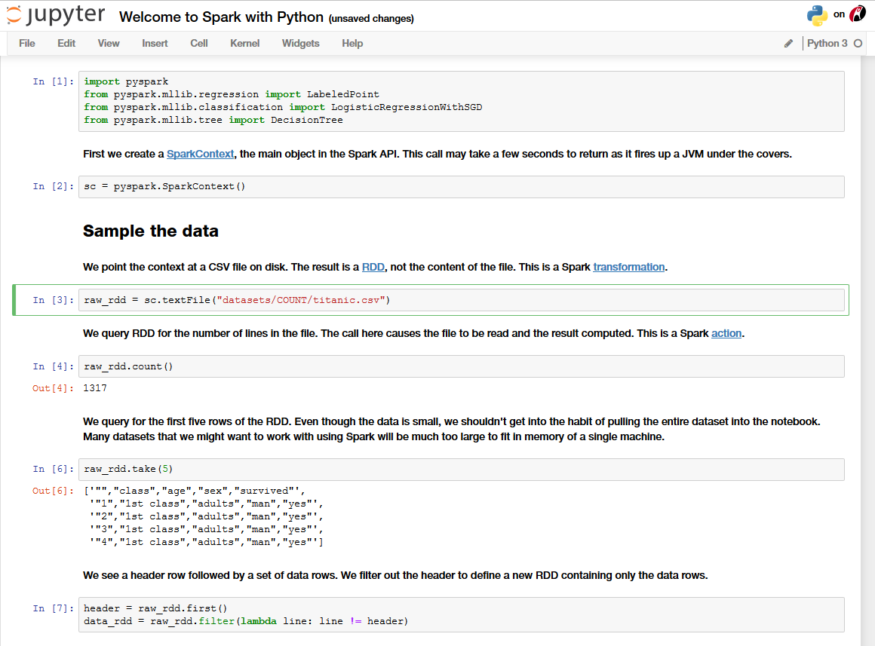
Accessing Spark with pyspark…
mllib is the Spark Machine Learning Librry
Import pyspark module
Set the Spark context
Resilient Distributed Dataset
Point context to HDFS file
Reads the data in Spark
Sample the data

Slide 43
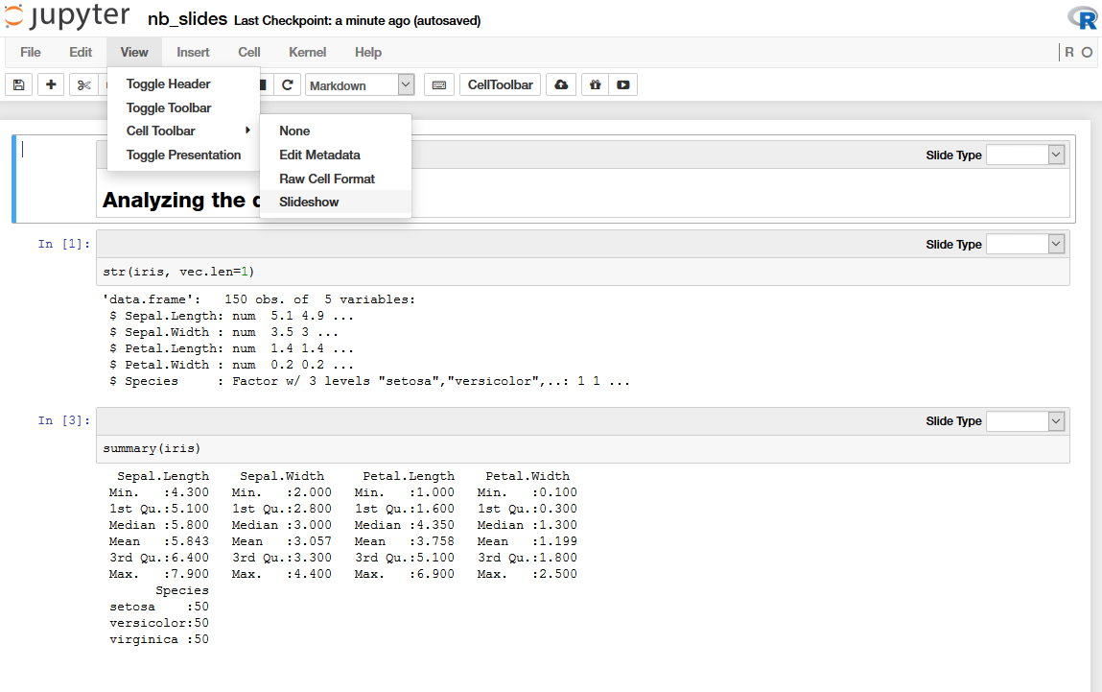
Presentations from Jupyter…
Switch to Slideshow Mode
Organize Slides

Slide 44
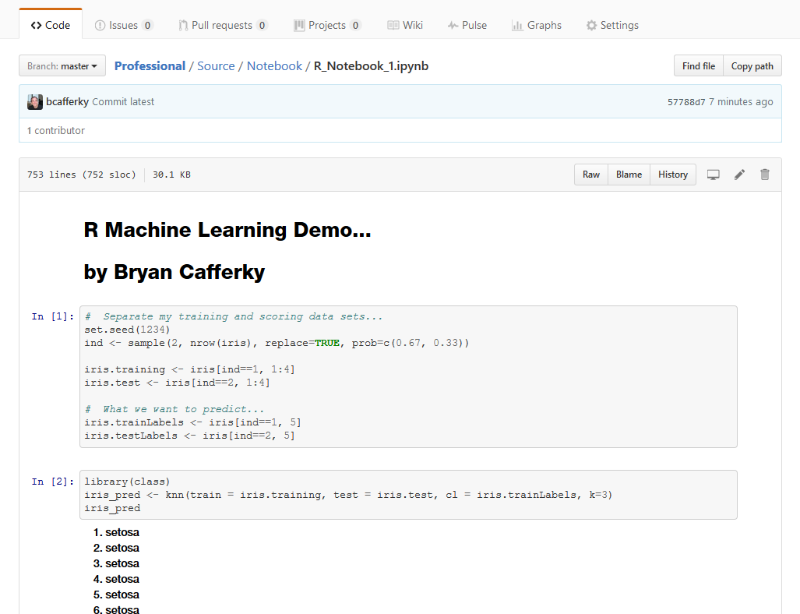
Github Renders Notebooks Automatically…

Slide 45
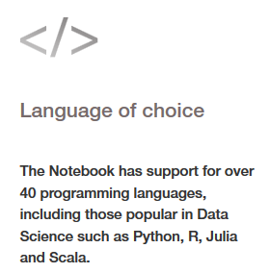
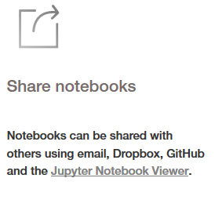
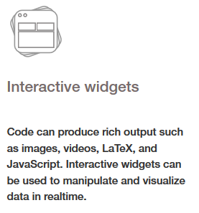
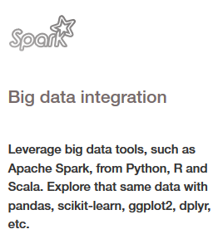
Advanced Data Science Tool

Slide 46
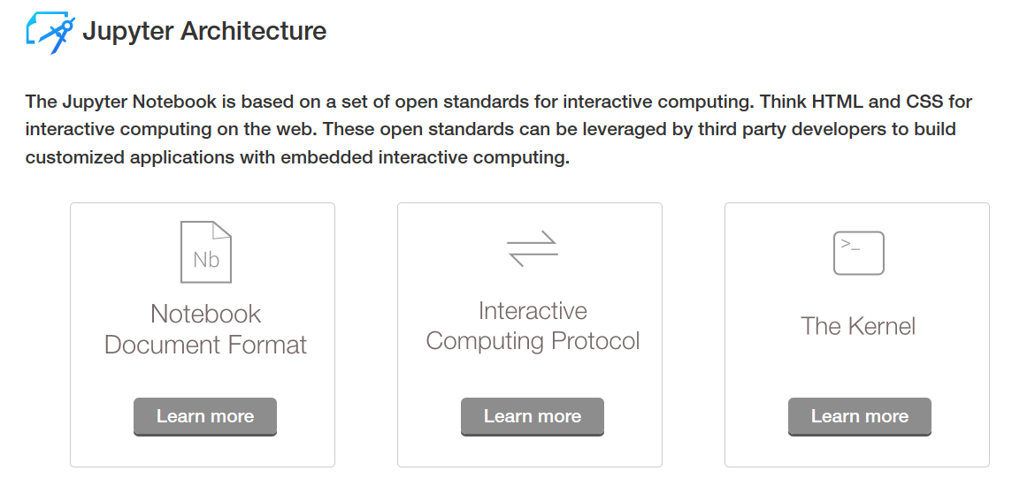
Architecture

Slide 47
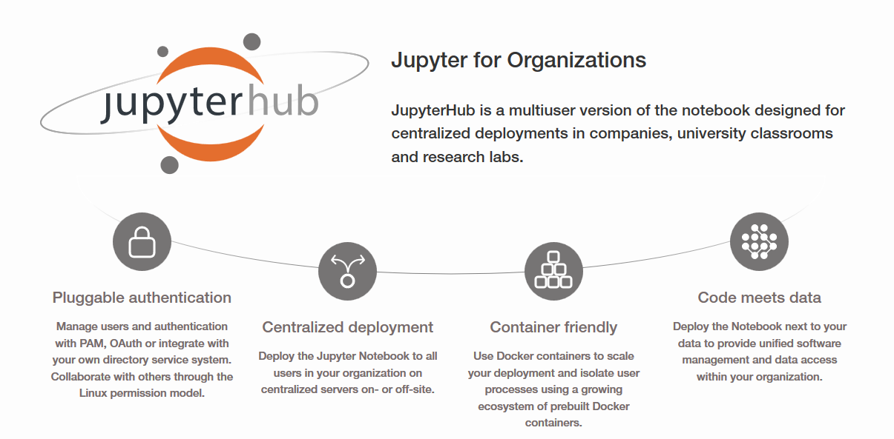
Features

Slide 48
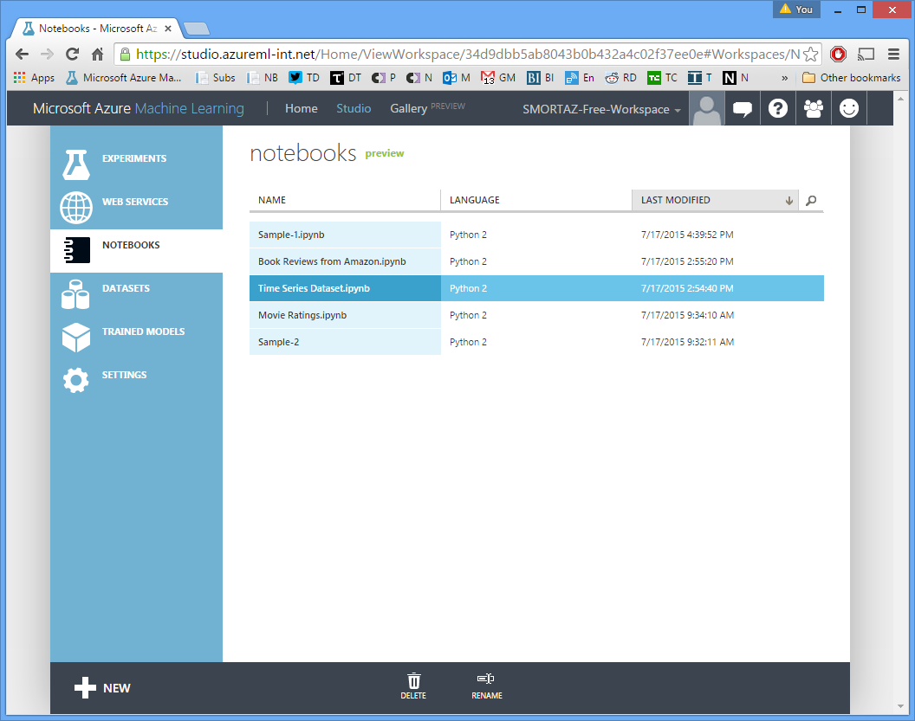
Jupyter Notebooks on Azure
Expand/
Collapse Control

Slide 49
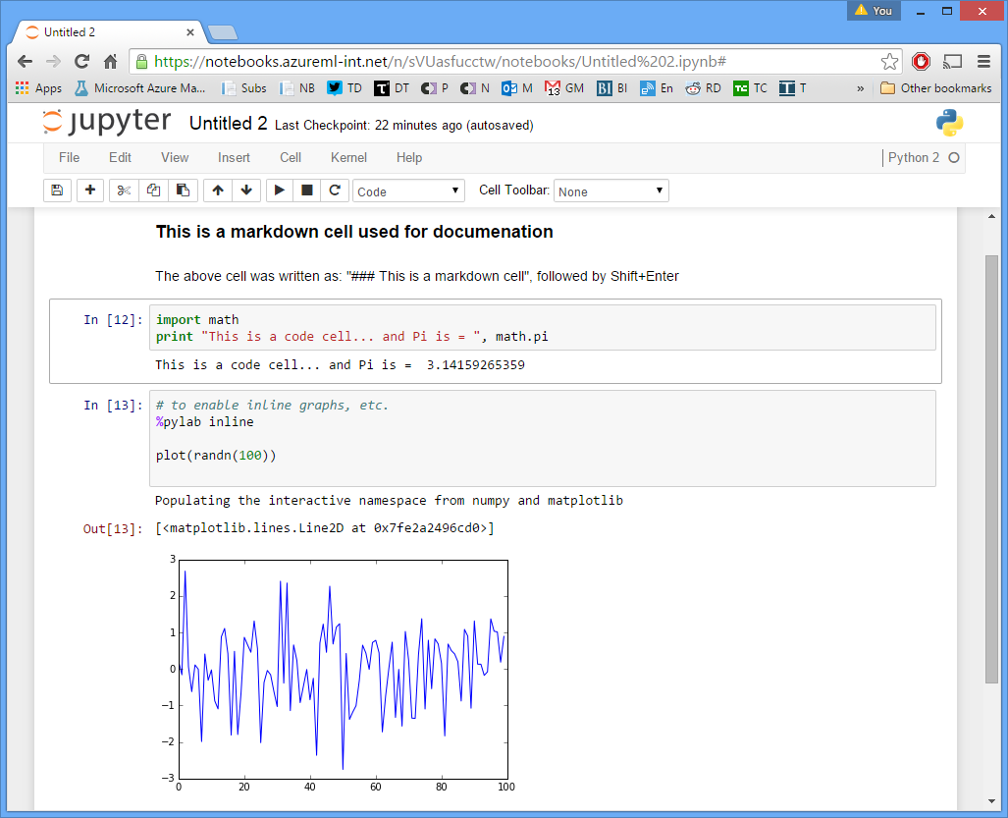
Jupyter Notebooks on Azure
Built-In Support to maintain notebooks.
Share with others.
Initially supports R, Python 2 and Python 3.

Slide 50
How to get Jupyter Notebook…

Slide 51
Installing Jupyter Notebook
Install Python – Jupyter is a Python application.
Recommend the Anaconda distribution which has many useful packages.
Choose 32 or 64 Bit as appropriate.
Either Python 2.x or Python 3.x will work. Python 3 is the new standard.
https://www.continuum.io/downloads
Install R if you do not have it installed. An R IDE is not required.
https://cran.r-project.org/bin/windows/base/

Slide 52
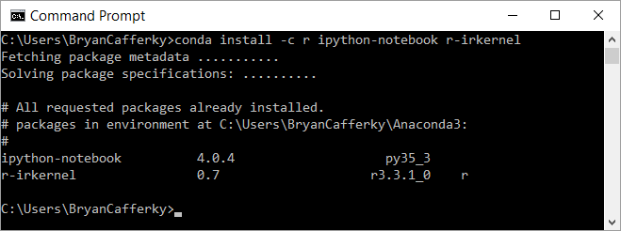
Installing Jupyter Notebook
Install the R Kernel with Extensions, i.e. popular R packages.
Windows Command Prompt

Slide 53
Jupyter Notebook – Wrapping Up
Key Features
Open Source
Written in Python – originally called IPython
Real time execution and rendering
Many languages supported
Supports Spark API
Sharing many ways, i.e. file system, GitHub, JupyterHub, Azure
Built-in Viewer Support in GitHub

Slide 54
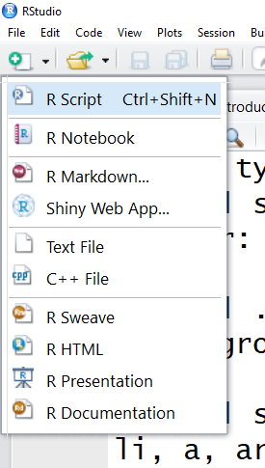
RStudio Features: Script Types
Standard R Script
Code and Output in One Document
Publishing
Interactive R Application
More Publishing

Slide 55
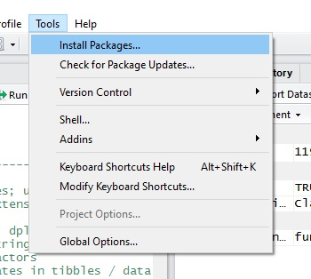
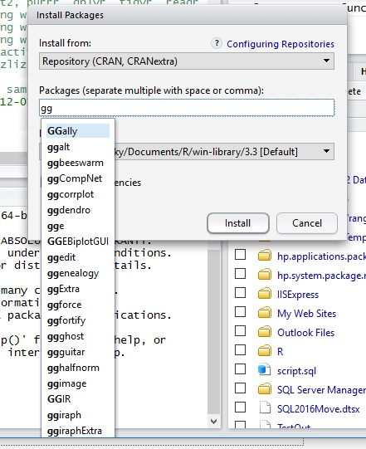
RStudio Features: Install Packages
Auto-Search

Slide 56
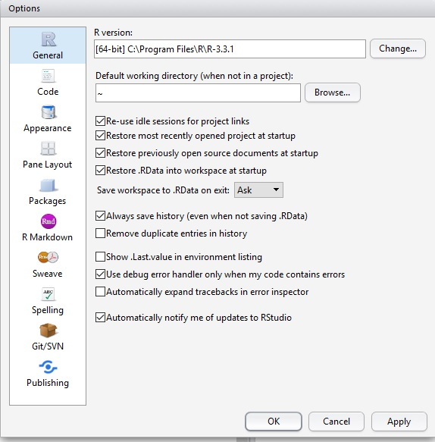

Review of Our Tour
RStudio Features: Options

Slide 57
Lab 1: Jupyter Notebooks

Slide 58
Part 2: R Programming Primer
Basic Syntax
Vectors
Matrixes
Arrays
Lists
Data Frames

Slide 59
What is R?
R is an open source language for Data Science.
scr_opening_speech.R

Slide 60




When to Use R?
Statistics
Visualization
Analysis
Exploration

Slide 61




Why Use R?
Career
Sharing

Slide 62

R Syntax
Case Sensitive – a is a different variable from A
Statements are function calls.
Braces mark blocks of code.

Slide 63
R Processing is Vector Based
Most Programming Languages work on a single data element at a time called a scalar value, i.e. X = 5
R Inherently works on sets of data called vectors, i.e. X = 1,3,4,5. This makes R ideally suited for statistics.
A Set of Numbers Is Processed with No Need to Iterate.

Slide 64
Vector Types
Integer – values 1,2,4,5,-4
Numeric – values such as 1.2, -2.6, 33.234, 55.88
Character – values such as “a”, “b”, “Harry”
Logical – values TRUE, FALSE
Raw – values such as 28, 6f, 6e for binary storage
Complex – values such as 5 + 2i where i is imaginary units

Slide 65
Vector Types
class() function returns a vector’s data type.
is. series of functions test for the specific data type.
is.integer()
is.numeric()
is.character()
is.logical()
is.raw()
is.complex()

Slide 66
Categorical Variables
Sometimes statistical calculations need to be grouped by a category.
Examples include:
Average Sales by Payment Type
Population by State
Statistical calculations only deal with numbers. Descriptive, non numeric values, must be assigned a number to group them together for analysis.

Slide 67

R Factor = Categorical Variable
In R, categorical variables are called Factors.
An example of how a factor works is below.
What’s Displayed
What’s Used In Calculations

Slide 68

Factors in Use
Factors are used for grouping data as shown below.
The measure to plot
How to group the measure
boxplot(iris$Sepal.Length ~ iris$Species, col = c("red", "darkgreen", "lightblue"))

Slide 69

What is a Matrix?
A Matrix is a two dimensional vector.
It consists of columns are rows.
All elements of a matrix must be the same data type.

Slide 70


Creating a Matrix
Use the matrix function to create a matrix…
as.matrix only returns 1 column with one row per value…

Slide 71



Matrix Functions
class returns the object type..
is.matrix returns TRUE if the parameter is a matrix
dim returns the number of rows and columns in the matrix

Slide 72

What is an Array?
An Array is a multidimensional vector.
Usually has three or more dimensions.
All elements of an array must be the same data type.

Slide 73

Creating an Array
Use the array function to create an array…

Slide 74



Array Functions
class returns the object type..
is.array returns TRUE if the parameter is an array
dim returns the number of rows and columns in the array

Slide 75

Accessing Array Elements

Slide 76

What is a List?
A vector of objects.
An object can be practically anything, i.e. a vector, matrix, array, another list.
Lists can be nested, i.e. can contain a lists which contains lists.
Are the basis for object orientated programming in R.
http://admin.utep.edu/Default.aspx?tabid=74353

Slide 77
Creating a List
Using the list function to create a list…

Slide 78
R Programming
Demo
Data Frame Exploration Notebook – Part 1

Slide 79

Data Frame
Data

Slide 80
Data Frame
An In Memory Table
Based on the List Object
Explicit and Implicit Data Frame Creation
Like a Matrix That Supports Different Data Types
Many Functions Support Data Frame Parameters

Slide 81
Creating a Data Frame
Explicitly using the data.frame function.
Implicitly when data is loaded by a function such as read.csv.

Slide 82

Data Frame

Slide 83
Functions
Defines a Block of Code That Can Be Called By Name
Avoids Repetition of Code
Can Be Called Any Number of Time
Information Can Be Passed to the Function as Parameters

Slide 84

Functions
Function function returns a function
Defines function but does not execute it
Calling the function

Slide 85

apply functions
Parameters:
Variable
1 for column, 2 for row
function
1st Letter indicates return type
List in, List out

Slide 86

Jump Start with SQL using sqldf
Adds Structured Query Language (SQL) Support
Manipulate Data Without Learning New Functions
Easy to Use and Understand
Relies on SQLite

Slide 87
Data Frame Shaping
Add and Remove Columns
Add and Remove Rows
Update Values
Sorting
Dealing with missing values.

Slide 88
Data Frame Slicing & Filtering
We can access data.frame columns by name.
MyDataFrame$FirstName
We can access rows and columns by subscript.
MyDataFrame[,3]
The attach function makes referencing columns easier
attach(MyDataFrame)
print(FirstName)

Slide 89

Data Frame Shaping

Slide 90

Data Frame: Handling Missing Data
Which values are missing?
Convert values to NA
Remove NA Values

Slide 91

Data Quality and Data Wrangling
Reasons for Incorrect and Missing Data
What’s the Impact?
Identification and Correction
Thoughts on Data Quality

Slide 92

Review
Data Frames – Slicing, Dicing
Data Frame Shaping
Handling Missing Values
Impact of Missing Data

Slide 93
Review of Our Tour
Demo
Exploring Data Frame Notebook – Part 2

Slide 94

Review of Our Tour
Packages

Slide 95
What is a Package?
A collection of functions and/or data that can be easily shared
Used to extend R capabilities
Community Developed
Downloaded from Repositories
A Library is the folder where the packages are stored

Slide 96
Installing a Package
Use the install.packages function to download and install from CRAN.
install.packages(“dplyr”)
To download and install from GitHub, you need to install “devtools”.
install.packages(“devtools”)
Then install packages from GitHub
library(“devtools”)
install_github("hadley/babynames")

Slide 97
Review of Our Tour
Installing Packages from Other Repositories
install_bioc()
install_bitbucket()
install_git()
install_local()
install_svn()
install_url()
install_version()

Slide 98
Review of Our Tour
Getting Help on Packages
Get Help in general
help.start() or help(functionname)
Get Help on how to use a package
help(package = "babynames")
View vignettes that explain the package
browseVignettes(package="dplyr")
View information all packages in CRAN
https://cran.r-project.org/web/packages/available_packages_by_name.html

Slide 99


Package
Demo

Slide 100
Popular Packages: dplyr
Functions to manipulate data
Supports filtering, aggregating, sorting, grouping
Merge Data Sets
Create New Columns

Slide 101
Popular Packages: ggplot2
Supports Sophisticated Visualizations
Implements the Grammar of Graphics
Let’s Us Layer Our Graphics
Very Popular

Slide 102
Packages
Demo
dplyr
Sqldf
ggplot2

Slide 103
Lab 2
Fun with Publicly Available Data

Slide 104

Part 2 – R Basics End

Slide 105
Background on Data Science
Statistics
Data Frame Shaping
Accessing Data
Data Quality & Wrangling

Slide 106

Statistics: What You Need to Know
Statistics Relationship to Data Science
What is Statistics?
Basic Concepts
Distribution & Standard Units

Slide 107
Data Science: Revolution or Evolution
Data Science is Not New! (S and SAS languages started in 1976)
Focus on and Explosion of Volume of Data – Requires Statistics
Faster Computers & Scaling Technologies / Cloud
New Hype = New Terms
Big Data and Machine Learning Usually Work in Tandem

Slide 108


Statistics & Data Science Roles
Data Scientist
Advanced Degree in Statistics
Research/Discovery Orientated
Conceptualize/Develop Models
Analyst
Has deep domain knowledge
Blends Operational Reporting & Analytics
Some Knowledge of Statistics
Less Complex Models/Solutions
Data Engineer
Focuses on Scaling Up/Out and Automation
May Modify Solution/Model to Scale It
Basic Understanding of Statistics and Models

Slide 109

What is Statistics??
Collection
Analysis
Interpretation
Presentation
Insight

Slide 110

Relationships Between Variables
Age to Disease
Population to Crime
Drug to Recovery
Age, Education to Income

Slide 111
Concepts
Range – Difference between the lowest and highest value
Central Tendency – Point where the values tend to cluster.
Distribution – How the values spread out.
Outlier – An exceptionally large or small value.
Variance – How far the values are spread out.

Slide 112
Central Tendency
Mean (Average) = Sum of Values / Count of Values
(8 + 10 + 6 + 40 + 30) / 5 = 18.8
Median (Middle Value)
8, 10, 6, 40, 30
Sort Values Lowest to Highest
6, 8, 10, 30, 40
Median = Middle Value
Mode (Most Frequently Occurring Value)
Mode = 8
6, 8, 8, 8, 40

Slide 113

Quartiles
Splitting the Data Into Fourths
Normal
Distribution
25%
25%
25%
25%
Lowest
Q1
Q2
Q3
Q4
Highest

Slide 114

Using R to Visualize: Box Plot
Getting a sense of the range, distribution, and central tendency
Highest Value
3rd Quartile
Median
2nd Quartile
Lowest Value

Slide 115

Distribution
What is Distribution?
Normal Distribution
Standard Units – Comparing Apples to Apples

Slide 116

Normal Distribution
Values Cluster Towards the Center
Mean = Median = Mode
Symmetrical
Area Under the Curve Equals 1
Many Populations Have a Normal Distribution
https://www.mathsisfun.com/data/standard-normal-distribution.html

Slide 117

Standard Units
Must Have Normal Distribution
Calculate the Standard Deviation
The Standard Deviation is the Unit
The Mean is Zero
The Unit is Replaced with a Proportion
https://people.hofstra.edu/Cong_Liu/PSY40/8_Lab.html

Slide 118
Statistics
Demo

Slide 119
Review
Statistics Relationship to Data Science
What is Statistics?
Basic Concepts
Distribution & Standard Units

Slide 120

Part 3: Data Frame Shaping and Wrangling
Data

Slide 121

Data Relationships

Slide 122
Evaluating Data Relationships
Relationships Among Variables (Correlation)
Linear and Nonlinear Relationships
Correlation vs. Causality
Multivariate Correlation

Slide 123

Relationships Among Variables (Correlation)
Correlation is the Relationship Between the Value of Variables
Variables Tend to Change Together
Can We Use Historical Correlation to Estimate the Future Value of a Variable?

Slide 124

Correlation - Linear
Example: Gross Sales related to Profit, i.e. the more sales revenue, generally the more profit. Assume X is Sales and Y is profit over a series of years.
The points are the actual sales/profit. The line is attempting to get the average. This is an example of a linear relationship.

Slide 125
Understanding Correlation
Calculated as a Number Between 0 and 1
Zero Means No Relationship
One Means 100% Correlation
Negative Value Indicates an Inverse Relationship
Predictive Modeling with R 125

Slide 126
Correlation – Linear Relationship Examples
Foot size to height.
Study time to grades.
Distance to travel time.

Slide 127



Non Linear Relationships
Do Not Have a Constant Slope
Cookies cooling time after baking
Thrown Ball Height Over Time
Population Growth
https://www.montereyinstitute.org/courses/Algebra1/COURSE_TEXT_RESOURCE/U03_L2_T5_text_final.html

Slide 128

Determining the Type of Relationship
Scatterplots Can Help
Exponential Relationship
https://www.statcrunch.com/5.0/viewresult.php?resid=1656215

Slide 129
Multivariate Correlation
Using Multiple Variables Can Improve Correlation Strength
Inclusion of a Variable May Help or Hurt Predictive Effectiveness
Goal is to Find the Best Input Variables to Get Strongest Correlation

Slide 130

Review: Determining Correlation
library(psych)
pairs.panels(mymovies[,c('budget’, 'length’, ‘mpaa’, 'genre’, 'rating_class')])

Slide 131
Correlation Is Not Causation
Outcome Variable May Cause Input Variable
Confounders
Coincidence

Slide 132
Review
Relationships Among Variables
Linear and Nonlinear Relationships
Calculating Correlation
Correlation vs. Causality
Multivariate Correlation

Slide 133

Data Science and Machine Learning
Machine Learning

Slide 134

Data Science
What is Data Science?
Machine Learning - Supervised and Unsupervised Learning
Predictive Modeling
Data Mining
Research

Slide 135

What is Data Science?
Data science, also known as data-driven science, is an interdisciplinary field about scientific methods, processes, and systems to extract knowledge or insights from data in various forms, either structured or unstructured
How Can We Use the Inundation of Data to Learn New things.
https://en.wikipedia.org/wiki/Data_science

Slide 136

What is Machine Learning?
Branch of Artificial Intelligence that Allows Programs to Learn without Being Explicitly Programmed by Using Algorithms and Statistical Models.
Make Sense of the Many Various Forms and Volumes of Data.
Turn Data into Actionable Insights.

Slide 137

Unsupervised Learning
The Input Data is not Labeled, i.e. we don’t know what the data is.
The Goal is to Look for Patterns in the Data Such as Grouping, aka Clustering.
Example: Fraud Detection.

Slide 138

Predictive Modeling, Supervised Learning
Input Data is Fed into the Program
The Program is to Determine the Relationship Between the Input Columns and a Result Output Column
Based on Analysis of Inputs to Result, a Model is Created to Predict the Result Based on a Given Set of Inputs

Slide 139

Data Mining
Goal is to Find Patterns in the Data.
Can be Supervised or Unsupervised.
Result May Be Used to Create a Predictive Model.
Example: Market Basket Analysis.

Slide 140
Research/Population Comparison
Is a Pharmaceutical Effective?
Is the Lifestyle in Once Population Leading to Better Health?
Are Environmental Factors Affecting the Survival Rate of Possum?
Are Pesticides Negatively Impacting Consumers?
Goal: Prove a Hypothesis.

Slide 141
Review
What is Data Science?
Machine Learning - Supervised and Unsupervised Learning
Predictive Modeling
Data Mining
Research/Population Comparison

Slide 142


Slide 143
Creating a Predictive Model
What is a Predictive Model?
Identifying the Input Variables
Steps to Creating a Predictive Model
Evaluating the Model

Slide 144
What is Predictive Modeling?
Predictive Modeling attempts to determine an unknown variable based on known variables using probabilities.
Use the past to predict the future (Historical Data).
Use the Correlation between the Input Variables and the Variable to be predicted.

Slide 145
Applications of Predictive Modeling Modeling
Classify something such as is an is an email spam or ham?
What group does something belong to such as what species of plant?
Will a person contract a certain illness?
Will the patient be readmitted?
Is the person a high health risk?

Slide 146
Steps to Creating a Predictive Model
Analyze/Clean the Data
Determine the Columns that Predict the Answer
Select a Model to Use
Train the Model
Evaluate the Model’s Effectiveness
Use the Model

Slide 147
The Birth Weight (BirthWt) Data Set
Risk Factors Associated with Low Infant Birth Weight
Column | Meaning
age | mother's age in years.
lwt | mother's weight in pounds at last menstrual period.
race | mother's race (1 = white, 2 = black, 3 = other).
smoke | smoking status during pregnancy.
ptl | number of previous premature labors.
ht | history of hypertension.
ui | presence of uterine irritability.
ftv | number of physician visits during the first trimester.
bwt | birth weight in grams.
low | indicator of birth weight less than 2.5 kg.

Slide 148

Steps to Predictive Modeling

Slide 149
Demo
Demo – Part 4
Creating a Predictive Model
Based on the following sources:
https://www.r-bloggers.com/using-decision-trees-to-predict-infant-birth-weights/
http://blog.revolutionanalytics.com/2013/06/plotting-classification-and-regression-trees-with-plotrpart.html

Slide 150

Review: Extracting the Training/Testing Data

Slide 151

Review: Viewing the Decision Tree
library(rpart)
birthwtTree <- rpart(low ~ . - bwt,
data = birthwt[train, ],
method = 'class')
# Plot the Decision Tree
library(rattle)
fancyRpartPlot(birthwtTree,
main="Birth Weight")

Slide 152


Review: Evaluating the Model

Slide 153
Review
What is a Predictive Model?
Identifying the Input Variables
Steps to Creating a Predictive Model
Evaluating the Model

Slide 154
Lab 4: Predictive Models

Slide 155
End of Part 2 - Predictive Modeling

Slide 156

SQL Server/R Integration

Slide 157
R Limitations
Client side only tool. No server based processing.
Data limited by client memory.
Single threaded.
Database data must be imported to be used.
Relatively slow.
No scheduling tool.

Slide 158
Microsoft buys Revolution Analytics
Proprietary vendor providing scalability options.
Support for multi-threading.
Provide a shared R server.
Performant versions of common R functions.
Data not limited by memory.

Slide 159
SQL Server 2016: Reaching R's Potential
Stored procedures can be coded in R with the features that entails.
SQL Server and R share memory space.
Work can be split between SQL Server and R Server.

Slide 160

SQL Server Plus R = Value

Slide 161

SQL Server: R Operationalized
https://msdn.microsoft.com/en-us/library/mt590947.aspx

Slide 162

SQL Server: R Operationalized
https://www.youtube.com/watch?v=by2cJ9sQO0Q

Slide 163

SQL Server/R Architecture
https://www.youtube.com/watch?v=by2cJ9sQO0Q

Slide 164
Microsoft R Open
R Open - an open source R distribution from Microsoft that is fixed stable release.
CRAN is always adding updates to the R language which can be unstable.
Some enhanced performance math functions are included.
Is used in place of the standard CRAN R language download.
Must be used with R scalability features.

Slide 165
Microsoft R Client
Is a set of R packages.
Implements RScale functions but with limited scalability.
Useful for learning and development.
May be a good option when small only scale improvments are needed.

Slide 166
Microsoft R Server
Like an Express Edition of R Server.
A stand alone R execution environment.
Clients submit R requests to R Server for high speed processing.
Can be contained within other environments such as SQL Server.
Versions for Linux, Hadoop and Teradata.
Tight integration with SQL Sever.

Slide 167
Microsoft R Open
Proprietary high performance functions used in place of the standard R functions.
Start with the prefix 'rx', i.e. rxImport.
Can be used with Microsoft R Client (free) or R Server but severly limited scalability on R Client.
scaleR Functions https://msdn.microsoft.com/en-us/microsoft-r/scaler/scaler

Slide 168
SQL Server: DeployR
Known as the R Integration Server.
An optional framework for deploying R analytics inside web, desktop, mobile, and dashboard applications as well as backend systems.
Provides analytics services such as a predictive model as a web service.
Used on Azure Machine Learning.

Slide 169
Must Install Needed Packages

Slide 170

SQL Server Launchpad Service

Slide 171
Demo
SQL Server R Services Demo
SQL R Services End to End Notebook

Slide 172
Lab: SQL Server/ML Server
IntroTutorialInMicrosoftR Notebook

Slide 173
Online Tutorial: SQL Server/ML Server
https://www.microsoft.com/handsonlabs/SelfPacedLabs#keywords=r%20services&page=1&sort=Newest

Slide 174
End of Part 5 - SQL Server/R Integration

Slide 175
Supercharing Power BI with R

Slide 176

The Story of the Five Iron

Slide 177

Power BI with R

Slide 178

Using R with Power BI

Slide 179

It was rumored that the Apple logo was in honor of this pioneer of Computer Science.

Slide 180
It was rumored that the Apple logo was in honor of this pioneer of Computer Science.
Alan Turing – an apple with a bite out of it was found next to him.

Slide 181
Why Use R?
Can do things in Power BI that cannot be done without it.
Tell stories involving machine learning.
Show the research, i.e. how did we get here.
Extend your skillset.
Data Exploration.

Slide 182


Enabling R Scripts
Select Options

Slide 183


Power BI R Script as a Data Source

Slide 184

Power BI R Script as a Data Source
Load an installed package.
Function returns a data frame.
New data frame based on value_adjusted
Remove unneeded data frame.

Slide 185

Power BI R Script as a Data Source

Slide 186

Power BI R Script as a Data Source

Slide 187
Demo
Loading Data from an R Script
r_adjusted_values_load.r

Slide 188

Windows with AI Enabled

Slide 189

Transformation Script
Click on Edit Queries

Slide 190

Transformation Script
Click on Transform
Click on Run R Script

Slide 191

Transformation Script
Power BI Passed Data In as the dataset data frame.
Data is returned via the output data frame.

Slide 192
Demo
Transforming Data from an R Script
scr_transformation.r
Scr_power_bi_sales_adjusted_measure

Slide 193

Visualizations with R
Click on R

Slide 194

Visualizations with R
Expand Code Window

Slide 195

Visualizations with R
Data passed to Script as dataset data frame.

Slide 196

Visualizations with R
Packages must be installed.
Code renders visualization.

Slide 197

Visualizations with R
Run Script
Script Options
Go To R IDE
Expand/Contract Script Pane

Slide 198
Demo
Loading Data from an R Script
r_visualization.r

Slide 199
Visualizations with R

Slide 200

Visualizations with R
Click to Edit R Script

Slide 201
Demo with Predictive Model

Slide 202
Data Sources
Built In R Data
data()
MRAN
R Packages that Get Data
https://mran.microsoft.com/documents/data/
http://blog.revolutionanalytics.com/2016/01/new-data-sources-for-r.html

Slide 203
Review
R is a popular open source data science language.
The Comprehensive R Archive Network (CRAN) maintains R.
R has rich support for statistics and visualizations.
R is a vectorized language.
R is Extended with new Functionality via Packages.

Slide 204
End of Part 6 – Power BI with R

